Slide 1
HOME AUTOMATION
MADE BY:
PRABAL BHATNAGAR
HIMALI GOEL
SHIKHA VERMA
T.S.S.S SRINIVAS

Slide 2
INTRODUCTION
AIM:
To build a digital door locking system with the capability to control most of the home appliances via a bluetooth device to control all the system using a mobile app.
To Control the room lights according to the presence of light in the room using a light sensor.
The basic control of the appliances will be allowed only when the door is unlocked. In a situation when the digital lock is asserted(i.e. door is locked), all appliances will remain switched off.

Slide 3
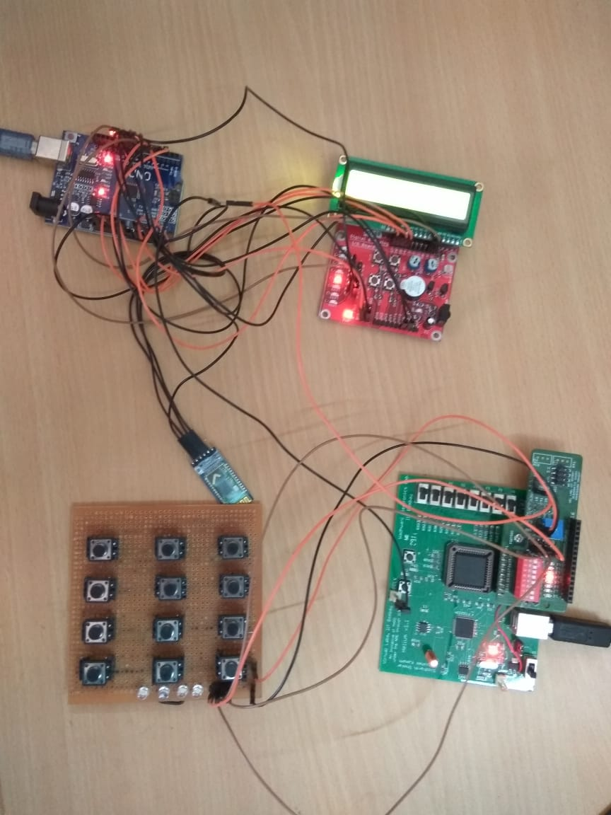
COMPONENTS :
HELIUM BOARD
ARDUINO UNO BOARD
DIGITAL I/O BOARD
HC05 BLUETOOTH MODULE
LCD DISPLAY

Slide 4
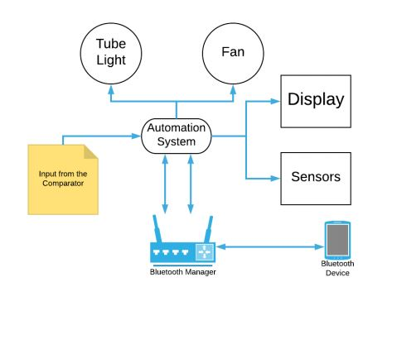
IMPLEMENTATION
PASSWORD IS ENTERED THROUGH A KEYBOARD
BINARY PASSWORD IS CONVERTED INTO DECIMAL
THE COMPARATOR CHECKS THE PASSWORD
ON PRESSING ENTER, LED1 LIGHTS UP FOR A CORRECT PASSWORD AND LED2 FOR A WRONG PASSWORD
THREE CONSECUTIVE WRONG PASSWORDS CAUSE THE BUZZER TO BLOW
ONCE THE DOOR IS SUCCESSFULLY UNLOCKED,THE USER IS GIVEN CONTROL OF HOME APPLIANCES
TO ENHANCE THE USE OF APPLIANCES, FOR EG LIGHT, A PHOTO DETECTOR HAS BEEN USED
THE USER IS ASKED FOR CONFIRMATION FOR TURNING ON THE LIGHT IN CASE THE LIGHT SENSOR DETECTS ENOUGH LIGHT IN THE ROOM

Slide 5
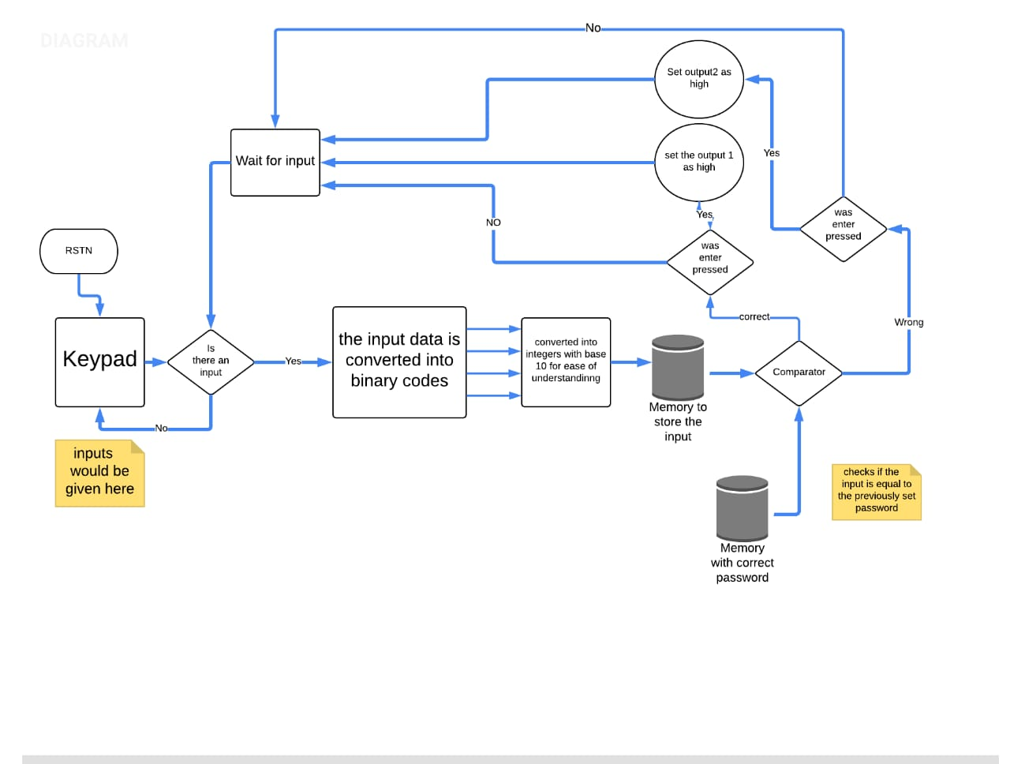

Slide 6
MODIFICATION POSSIBILITIES:
COMMUNITCATION THROUGH WIFI MODULE TO TURN SOME APPLIANCES SUCH AS AC ON PRIOR TO ARRIVAL AT HOME
TEMPERATURE SENSORS TO CONTROL SPEED OF FAN/HEATER
TO IMPROVE HOME LOCKING SYSTEM, WE CAN SEND AN SMS TO THE HOUSE OWNER ON THE ENTRY OF THREE WRONG PASSWORDS

